Slide 1
Digital Portfolio
STUDENT NAME: S. PRITHIKA
REGISTER NO AND NMID: 24724U18022&astvu24724724u18022
DEPARTMENT: COMPUTER SCIENCE
COLLEGE: COLLEGE/ UNIVERSITY:CHEZHIAN ARTS AND SCIENCE COLLEGE FOR WOMENCOLLEGE AND THIRUVALLUVAR UNIVERSITY

Slide 2
PROJECT TITLE
HAIR AND MAKEUP ARTIST PORTFOLIO

Slide 3


AGENDA
Problem Statement
Project Overview
End Users
Tools and Technologies
Portfolio design and Layout
Features and Functionality
Results and Screenshots
Conclusion
Github Link
3/21/2024 Annual Review

Slide 4

PROBLEM STATEMENT
Problem Statement
Hair and makeup artists usually depend on social media to show their work, but it is not enough to present their skills in a professional way. Clients face difficulty in viewing the artist’s portfolio, knowing about their achievements, and contacting them easily.
There is a need for a personal portfolio website that can clearly display the artist’s work, skills, certifications, client feedback, and provide simple ways to connect for bookings.

Slide 5

PROJECT OVERVIEW
Project Overview
This project is about creating a personal portfolio website for a hair and makeup artist. The website will showcase the artist’s work, skills, certifications, achievements, and client feedback in an attractive and professional manner. It will include sections such as About Me, Services, Featured Projects, Testimonials, Blog/Insights, and Contact. The portfolio helps the artist build a strong online presence, highlight their creativity, and provide an easy way for clients to connect and book service

Slide 6

WHO ARE THE END USERS?
End Users
1. Clients / Customers – People who want to book hair and makeup services for weddings, events, photo shoots, or personal grooming.
2. Event Planners / Photographers – Professionals who collaborate with makeup artists for projects and events.
3. Recruiters / Agencies – Beauty salons, fashion houses, or modeling agencies looking to hire or partner with talented artists.
4. General Audience – Visitors who admire the artist’s work, follow beauty trends, or read the blog/insights section

Slide 7

TOOLS AND TECHNIQUES
Tools:
Tools and Techniques
HTML, CSS, JavaScript – for website structure, styling, and interactivity
VS Code / Sublime Text – for coding
Figma / Canva – for designing layouts and graphics
GitHub / Git – for version control
Web Hosting (e.g., Netlify/Hostinger) – to publish the websit
Techniques:
Responsive Web Design – to make the site work on mobile, tablet, and desktop
Interactive UI/UX Design – for smooth navigation and user experience
Image Optimization – to showcase high-quality makeup and hairstyle images without slowing the site
SEO (Search Engine Optimization) – to make the portfolio visible on Google search
Client Feedback Integration – adding testimonials and reviews for trust-building

Slide 8
POTFOLIO DESIGN AND LAYOUT
Portfolio Design and Layout
Theme: Dark nylon color theme for an elegant and professional look.
Header: Interactive navigation bar with logo and menu links.
Hero Section: Large background image/video with artist’s name and tagline.
About Me: Short introduction, photo, and skills.
Services / Tech Stack: List of makeup and hairstyle services with icons.
Featured Projects: Gallery of past works with images and short descriptions.
Testimonials: Client reviews to build trust.
Achievements & Certifications: Awards, training, and certificates.
Blog/Insights: Beauty tips, trends, and personal posts.
Contact Section: Form, email, and social media link
8

Slide 9
FEATURES AND FUNCTIONALITY
Features and Functionality
Interactive Header & Navigation – Easy access to all sections.
Hero Section – Highlights artist’s name, tagline, and main work.
About Me – Showcases artist’s skills, experience, and profile.
Services Offered – Displays makeup, hairstyle, and beauty services.
Portfolio / Gallery – High-quality images of previous work.
Testimonials – Client reviews for credibility.
Achievements & Certifications – Awards and training details.
Blog / Insights – Tips, trends, and updates.
Contact Form – Easy booking and inquiries.

Slide 10
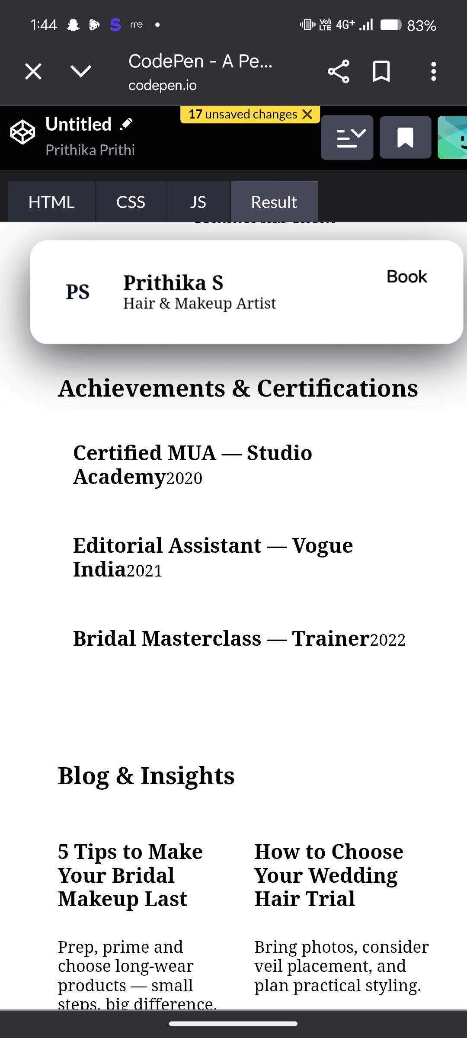
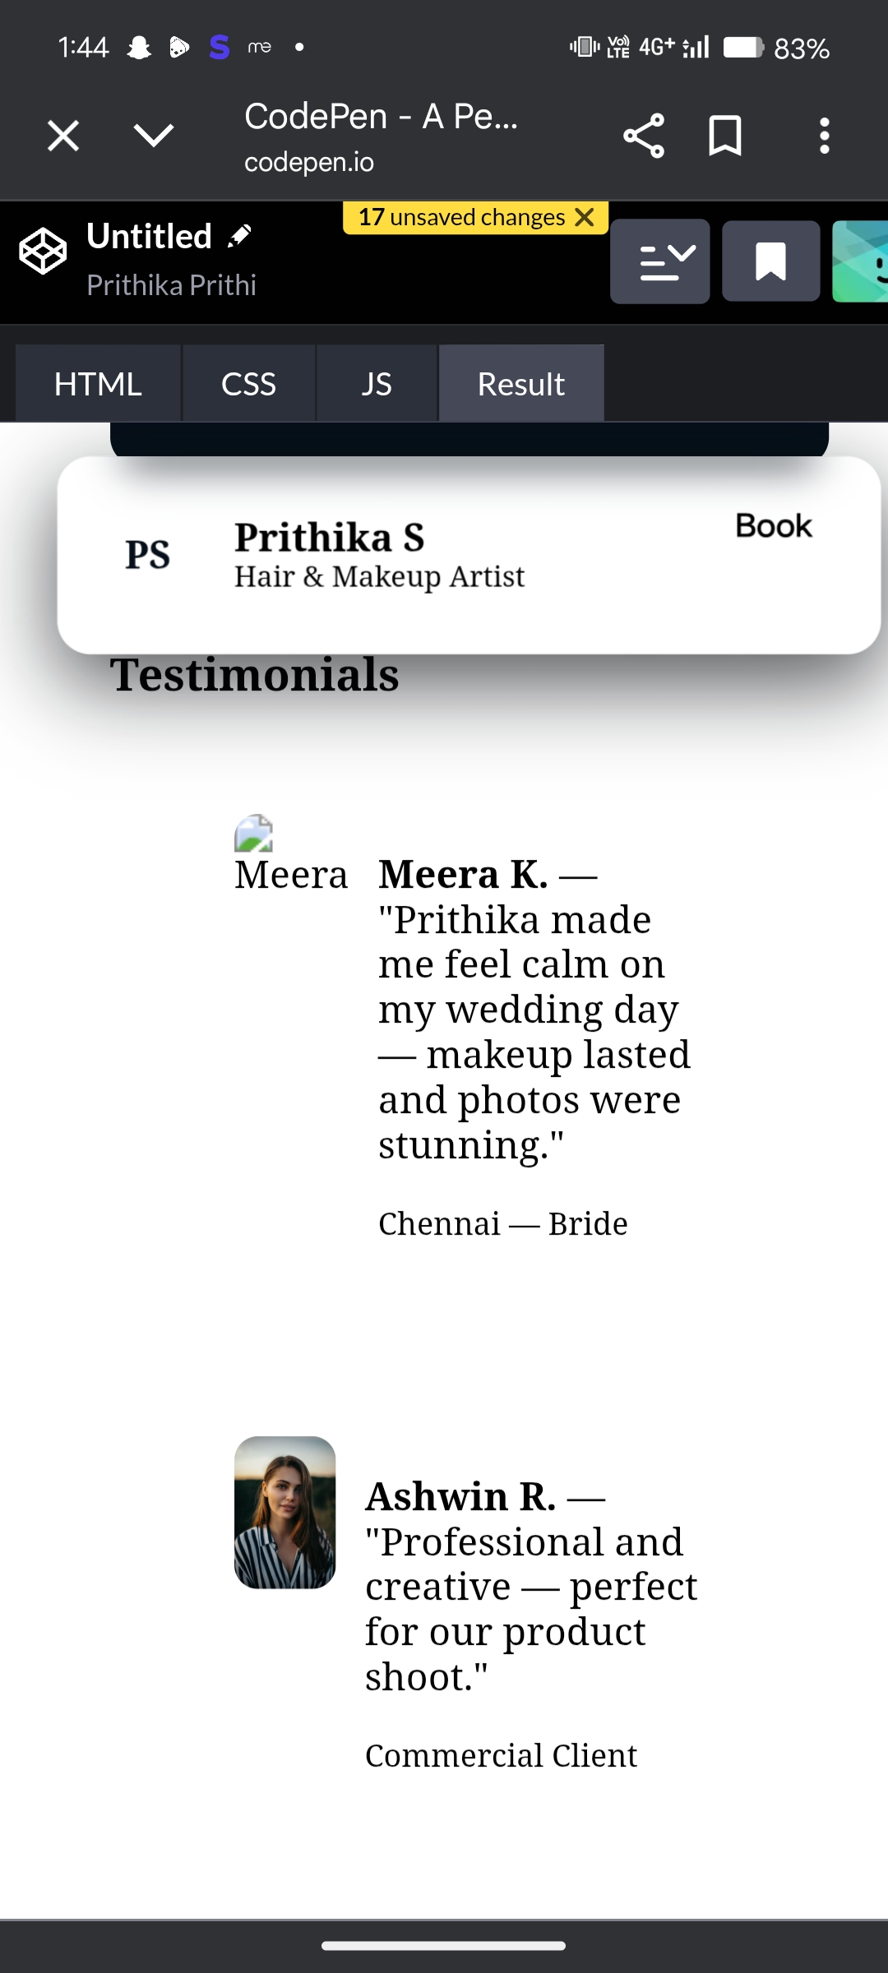
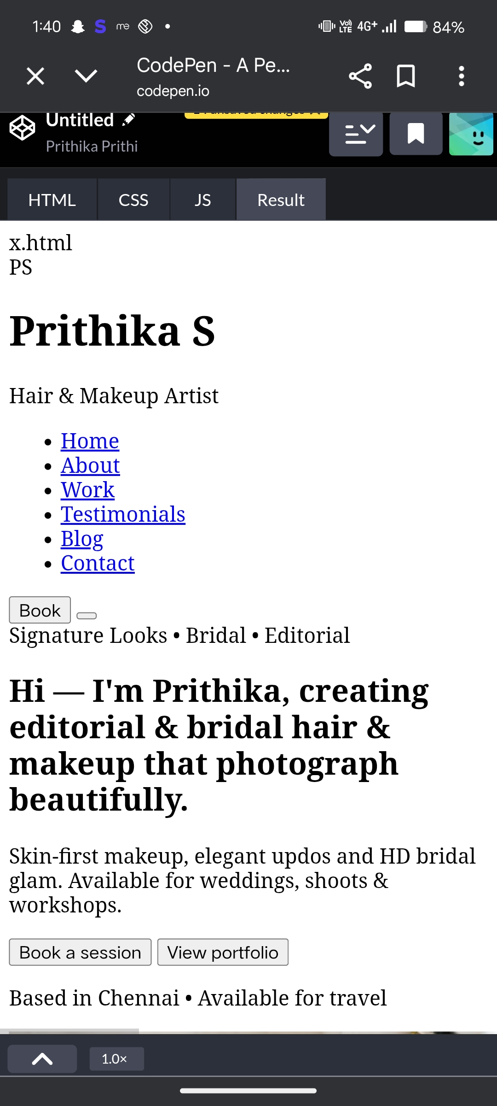
RESULTS AND SCREENSHOTS
3/21/2024 Annual Review
10

Slide 11
CONCLUSION
Conclusion
The Hair and Makeup Artist Portfolio website provides a professional platform to showcase the artist’s creativity, skills, and achievements. It allows clients to easily view services, explore previous work, read testimonials, and contact the artist for bookings. The project successfully meets the need for personal branding and online presence, helping the artist reach a wider audience and build credibility. With its responsive design and user-friendly layout, the portfolio enhances both client experience and professional growth.
11

